Slide 1
OBJECT-ORIENTED DATABASE DEVELOPMENT
THE IMPORTANCE OF OODBMS PRODUCTS
OBJECT DEFININITION LANGUAGE (ODL)
OBJECT QUERY LANGUAGE

Slide 2
The importance of OODBMS products
The need for storing and manipulating complex data is increasing. We can not use relational databases to store this kind of data.
The complex data types appear in several applications:
- CAD/CAM
- Geometric modeling
- Geographical Information Systems
- Knowledge-based systems / through frames
- Web applications that need to store, index, search
and manipulate diverse objects.

Slide 3
OBJECT DEFINITION LANGUAGE (ODL)
• Corresponds to SQL’s DDL (Data Definition Language)
• Specify the logical schema for an object oriented database
• Based on the specifications of Object Database
Management Group (ODMG)
In this section, we learn how to transform class diagram to ODL schema.

Slide 4
Defining a class
class – keyword for defining classes
attribute – keyword for attributes
operations – return type, name, parameters in parentheses
relationship – keyword for establishing relationship.
class Student {
attribute string name;
attribute Date dateOfBirth;
attribute string address;
attribute string phone;
// plus relationships and operations …
};

Slide 5
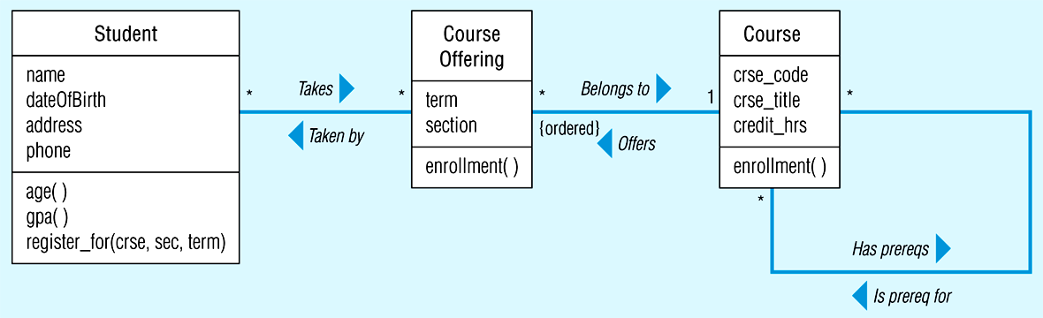
class Course {
attribute string crse_code;
attribute string crse_title;
attribute short credit_hrs;
// plus relationships and operation …
};

Slide 6
Defining an attribute
Value can be either:
Object identifier or literal
• Types of literals
Atomic – a constant that cannot be decomposed into components
Collection – multiple literals or object types
Structure – a fixed number of named elements, each of which can be literal or object type
• Attribute ranges: Allowable values for an attribute
enum – for enumerating the allowable values

Slide 7
Kinds of collections
• Set – unordered collection without duplicats
• Bag – unordered that may contains duplicates
• List – ordered collection, all the same type
• Array – dynamically sized ordered collection,
locatable by position
• Dictionary – unordered sequence of key-value
pairs without duplicates.

Slide 8
Defining Structures
Structure = user-defined type with components.
Use struct keyword
Example:
struct Address {
string street_address;
string city;
string state;
string zip;
};
struct Phone { short area_code;
long personal_number;
};

Slide 9
Defining operations
• Return type
• Name
• Parentheses following the name
• Arguments within the parentheses
Note: If an operation does not return a value, then
return type will be void.

Slide 10
class Student {
attribute string name;
attribute Date dateOfBirth;
// use-defined structured attributes
attribute Address address;
attribute Phone phone;
// plus relationships
// operations
short age();
float gpa();
boolean register_for(string crse, short sec, string term);
};

Slide 11
Defining a Range for an Attribute
If we know all possible values that an attribute can have, we can enumerate those values in ODL, using the enum keyword.
class CourseOffering {
attribute string term;
attribute enum section {1, 2, 3, 4, 5, 6, 7, 8};
// operation
short enrollment( );
};

Slide 12
Defining relationships
• Only unary and binary relationships allowed.
• Relationships are bi-directional
- implemented through use of inverse keyword
• ODL relationships are specified:
- relationship indicates that class is on many-side
- relationship set indicates that class is on one-side and other class (many) instances unordered
- relationship list indicates that class is on one-side and other class (many) instances ordered.

Slide 13
Example: The relationships in Figure 7.1
class Student {
attribute string name;
attribute Date dateOfBirth;
attribute Address address;
attribute Phone phone;
relationship set<CourseOffering> takes inverse
CourseOffering::taken_by;
short age( );
float gpa( );
boolean register_for(string crse, short sec, string term);
};

Slide 14
Inverse keyword
The ODMG Object Model requires that a relationship be specified in both directions. In ODL, the inverse keyword is used to specify the relationship in the reverse directions.
class CourseOffering {
attribute string term;
attribute enum section {1, 2, 3, 4, 5, 6, 7, 8};
// many-to-many relationship between CourseOffering and Student
relationship set<student> taken_by inverse Student::takes;
// one-to-many relationship between CourseOffering and Course
relationship Course belong_to inverse Course::offers;
// operation
short enrollment( );
};

Slide 15
class Student {
(extent students)
attribute string name;
attribute Date dateOfBirth;
attribute Address address;
attribute Phone phone;
relationship set<CourseOffering> takes inverse CouseOffering::taken_by;
short age( );
float gpa();
boolean register_for(string crse, short sec, string term) ;
};
class CourseOffering {
(extent courseofferings)
attribute string term;
attribute enum section {1, 2, 3, 4, 5, 6, 7, 8};
relationship set<Student> taken_by inverse Student::takes;
relationship Course belong_to inverse Course::offers;
short enrollment( );
};

Slide 16
The ODL schema for university database
class Course {
(extent courses)
attribute string crse_code;
attribute string crse_title;
attribute short credit_hrs;
relationship set<Course> has_prereqs inverse Course::is_prereq_for;
relationship set<Course> is_prereq_for invers Course:: has_prereqs;
relationship list<CourseOffering> offers inverse CourseOffering::belong_to;
short enrollment();
};
Extent: The set of all instances of a class within the database. Format:
class class_name {
(extent extent_name)

Slide 17
Defining an Attribute with an OID as Its Value
The value of an attribute can be an OID, indicating an object.
Example:
class Course {
attribute Departement dept;
// other attributes, operations and relationship
…….
};
class Department{
attribute short dept_number;
attribute string dept_name;
attribute string office_address;
};

Slide 18
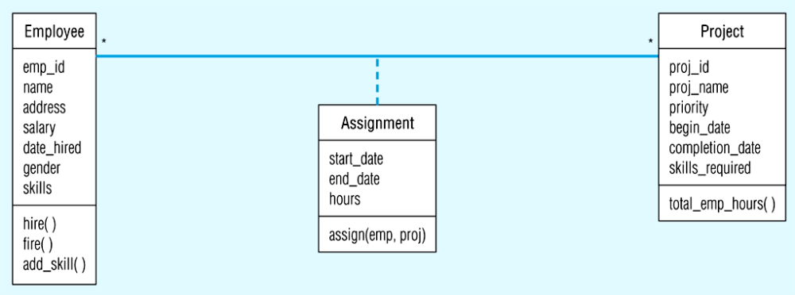
Defining Many-to-Many Relationships, Keys, and Multivalued Attributes
In case a many-to-many relationship is represented by an association class, we should break the relationship into two one-to-many relationship.

Slide 19
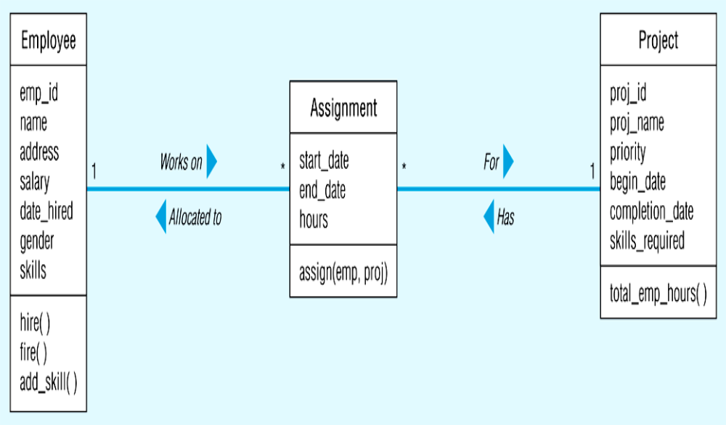
Association class

Slide 20
class Employee {
( extent employees
key emp_id)
attribute short emp_id;
attribute string name;
attribute Address address;
attribute float salary;
attribute Date date_hired;
attribute enum gender {male, famale}
attribute set<string> skills; // multivalued attribute
relationship set<Assignment> works_on
inverse Assignment::allocated_to;
void hire();
void fire() ;
void add_skill(string new_skill);
}

Slide 21
Example: Associastion class
class Assignment {
( extent assignments)
attribute Date start_date;
attribute Date end_date;
attribute short hours;
relationship Employee allocated_to inverse
Employee::works_on;
relationship Project for inverse Project::has;
// the following operation assigns an employee to a projects
void assign(short emp, string proj);
};

Slide 22
class Project {
( extent projects
key proj_id);
attribute string proj_id;
attribute string proj_name;
attribute enum priority {low, medium, high};
attribute Date begin_date;
attribute Date comletion_date;
attribute set<string> skills_required; //multivalued attribute
relationship set<Assignment> has inverse
Assignment::for;
long total_emp_hours( );
}

Slide 23
Note
1. Each instance of a class in OODB is unique; we do not require an explicit identifier to enforce the uniqueness of objects. However, specifying a key ensures that no 2 objects of a class have the same value for the key attribute(s).
The scope of the uniqueness is confined to the extent of the class. Hence, before specifying a key for a class, you have to specify its extent.
2. ODL also allows a composite key.
key { name, address}
3. In ODL, we can define a multivalue attribute using the set keyword.

Slide 24
Ternary Association Relationship
ODL does not support n-ary association relationships.
Therefore, we have to represent such a relationship by creating an association class and binary association relationships between the association class and related classes.

Slide 25
Defining an Aggregation Relationship
In ODL, we can represent an aggregation relationship by using an attribute declaration that creates an object set.
class Course {
(extent courses
key course_ID)
attribute set<Tutorial>;
…..
};
class Tutorial {
….
};

Slide 26
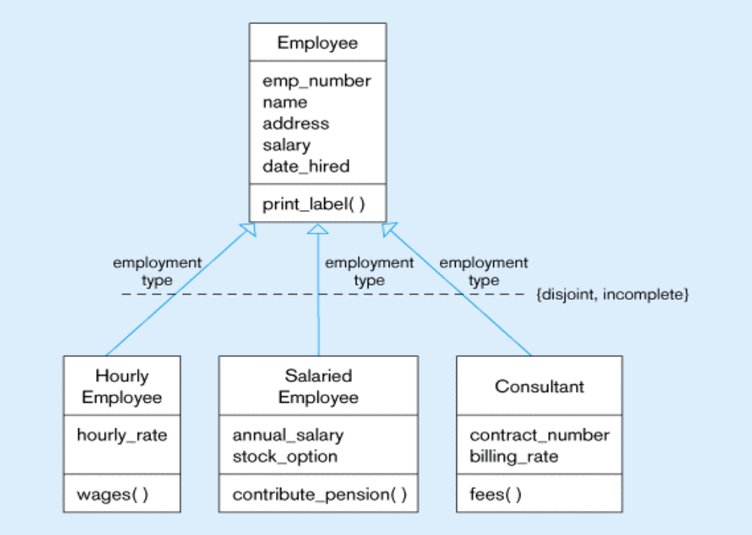
Defining Generalization

Slide 27
class Emloyee {
( extent employees )
attribute short emp_number;
attribute string name;
attribute Address address;
attribute float salary;
attribute Date date_hired;
void print_label();
};
class HourlyEmloyee extends Emloyee {
( extent hrly_emps)
attribute float hourly_rate;
float wages();
};
ODL allows to define generalization relationships by using extends keyword.

Slide 28
class SalariedEmloyee extends Emloyee {
( extent salaried_emps)
attribute float annual_salary;
attribute boolean stock_option;
void contribute_pension();
};
class Consultant extends Emloyee {
( extends consultants)
attribute short contract_number;
attribute float billing_rate;
float fees();
};

Slide 29
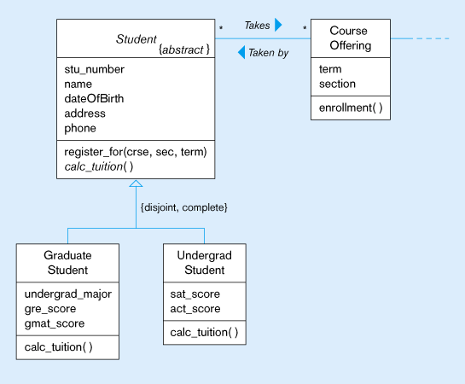
Defining an abstract class

Slide 30
Abstract Class
We use the abstract keyword to specify both the abstract class and the abstract operation.
abstract class Student {
( extent students
key stu_number)
attribute long stu_number;
attribute string name;
attribute Date dateOfBirth;
attribute Address address;
attribute Phone phone;
relationship set<CourseOffering> take inverse CourseOffering::taken_by;
boolean register_for(string crse, short section, string term);
abstract float calc_tuition(); // abstract operation
};

Slide 31
Defining other user structures
The schema definition contains user-defined structures.
Example:
struct GRE {
Score verbal_score;
Score quant_score;
Score analytical_score;
};
struct GMAT {
Score verbal_score;
Score quant_score;
};

Slide 32
OODB DESIGN FOR PINE VALLEY
FUNITURE COMPANY
Now we tranform the conceptual object-oriented model for the Pine Valley Furniture Company into a logical ODL schema, which may be used to implement an object-oriented database system for the company
Note: ODL is a specification language that is independent of the programming language used to implement the OO database schema later.

Slide 33
class Salesperson {
(extent salespersons
key salespersonID)
attribute string salespersonName;
attribute Phone salespersonFax;
attribute Phone salespersonTelephone;
relationship SalesTerritory serves inverse SalesTerritory::represented_by;
float totalCommission();
};
class SalesTerritory {
( extent salesterritories
key territoryID)
attribute char territoryID;
attribute char territoryName;
relationship set <Salesperson> represented_by inverse Salesperson::serves;
relationship set<Customer>consists_of inverse Customer::does_bussiness_in:
};

Slide 34
class Customer {
( extent customers
key customerID)
attribute string customerID;
attribute string customerName;
attribute Address customerAddress;
attribute float balance;
relationship set<SalesTerritory> does_business_in inverse SalesTerritory::consists_of;
relationship list<Order> submits inverse Order::submitted_by;
void mailinvoice(float amount);
void receivePayment(float amount);
};

Slide 35
class OrderLine {
(extent orderlines)
attribute short orderedQuantity;
relationship Order contained_in inverse Order::contains;
relationship Product specifies inverse Product::specified_in;
long orderlineTotal()
};
class Order {
(extent orders
key orderID)
attribute string orderID;
attribute Date orderDate;
relationship Customer submitted_by inverse Customer::submits;
relationship list<OrderLine> contains inverse OrderLine::contained_in;
float order Total();
};

Slide 36
class Product {
( extent products
key productID)
attribute string productID;
attribute string productDescr;
attribute char productFinish;
attribute float standardPrice;
relationship ProductLine belongs_to inverse ProductLine::includes;
relationship set<OrderLine> specified_in inverse OrderLine::specifies;
relationship set<WorkCenter> product_at inverse WordCenter::produces;
relationship set<RawMaterial> uses inverse RawMaterial::use_in;
float totalSales();
boolean assignProd(string line);
};

Slide 37
class ProductLine {
(extent productlines)
attribute string ProductLineName;
relationship list<Product> includes inverse Product::belong_to;
float totalSales();
};
class WorkCenter {
(extent worcenters
key workCenterID)
attribute char workcenterID;
attribute string location;
relationship set<Product> produces inverse Product::product_by;
relationship list<Emloyee> emloys inverseEmloyee::works_in;
};

Slide 38
class Vendor {
(extent vendors)
attribute string vendorName;
attribute Address vendorAddress;
relationship set<Supply> provides inverse Supply::provides_ by;
};
class Skill {
(extent skills)
attribute string skillName;
relationship set<employee> possessed_by inverse Emloyee::has;
};

Slide 39
class RawMaterial {
(extent rawmaterials
key materialID)
attribute string materialID
attribute enum unitOfMeasure {piece, box, carton, lb, oz, gallon, litre};
attribute float standardCost;
relationship set<Product> used_in inverse Product::uses;
relationship set<Supply> listed_in inverse Supply::lists;
};
class Supply {
(extent supplies)
attribute float unitPrice;
relationship RawMaterial lists inverse RawMaterial::listed_in;
relationship Vendor provided_by inverse Vendor::provides;
};

Slide 40
class Emloyee {
(extent employees
key emloyeeID)
attribute string emloyeeID;
attribute string emloyeeName;
attribute Address emloyeeAddress;
relationship set<WorkCenter> works_in inverse WorkCenter::employs;
relationship set<skill> has inverse Skill::possessed_by;
relationship Emloyee supervised_by inverse Emloyee::supervises;
relationship set<Employee> supervises inverse Emloyee::supervised_by;
boolean checkSkills(string product);
};
Note:
1.The collection of orderlines contained within an Order object is specified as a list.
2. Orderline is specified as an association class.
3. Supplies, a many-to-many relationship, is specified as an association class (Supply).

Slide 41
QUERYING OBJECTS IN THE OODB
• Object Query Language (OQL)
• As an ODMG standard language for querying OODBs.
• Strong similarity between SQL and OQL
OQL is supposed to be used as an extension to some object-oriented host language, such as C++, Smalltalk, or Java.
The ability to mix host language statements and OQL queries without explicitly transfering values between two languages is an advance over the way SQL is embeded into a host language in RDBMS.

Slide 42
Basic Retrieval Command
OQL allows us to write the basic query commands with the select-from-where syntax.
“Find the title and credits hours for MBA664.”
select c.crse_title, c.credit_hrs
from courses c
where c.crse_code = “MBA 664”
Note: The extent name courses is used in the SELECT command and in the FROM clause, the variable c is bound to the extent.

Slide 43
Including Operations in Select Clause
We can invoke operations in an OQL query similar to the way we specify attributes.
select s.age from student s
where s.name = “John Marsh”
This query returns an integer value.
A query can also return objects.
“Find all the student objects for which the gpa is greater than or equal to 3.0”
select s from students s
where s.gpa >= 3.0

Slide 44
select s
from students s
where s.gpa >= 3.0
and not (s.address.city = “Dayton”)
select s
from students s
where s.gpa < 3.0
Finding Distinct Values
select distinct s.age
from students s
where s.gpa < 3.0

Slide 45
Querying Multiple Classes
In an OQL query, we can traverse paths for the relationships defined in the schema.
“Find the course codes of all courses are offered in the Fall 1998 term”
select distinct y.crse_code
from courseofferings x
x.belong_to y
where x.term = “Fall 1998”
In FROM clause, we specify a path from a CourseOffering object to a Course object using the association relationship “belong_to”.

Slide 46
Another way:
select distinct y.crse_code
from courses y
y.offers x
where x.term = “Fall 1998”
Algorithm:
for each y in courses do
for each x in y.offers do
if x.term = “Fall 1998” then
add y.crse_code to the output bag.

Slide 47
“Find the number of students that register section 1 of the course MBA664”
select x.enrollment
from courseoffering x
x.belong_to y
where y.crse_code = “MBA 664” and x.section = 1
“Find course code, course name of all the courses that Mary Jones registers.”
select c.crse_code, crse_title
from student s
s.takes x
x.belong_to c
where s.name = “Mary Jones”

Slide 48
Path Expressions
The gereral rule is as follows:
If a denotes an object belonging to class C and p is some property of the class – either an attribute, relationship, or operation – then a.p denotes the result of “applying” p to a. That is
a) If p is an attribute, then a.p is the value of that attribute in object a.
b) If p is a relationship, then a.p is the object or collection of objects related to a by relationship p.
c) If p is an operation, then a.p is the result of applying p to a.

Slide 49
Complex Output Types
We can write a query that returns a structure as a result.
select distinct struct (name: s.name, gpa: s.gpa)
from student s
where s.name = “Mary Jones”

Slide 50
Writing subqueries: We can use a SELECT statement within a SELECT statement.
“Find the course code, course name, and course offerings for which the enrollment is less than 20.”
select distinct struct (code: c.crse_code, title: c_crse_title,
( select x from c.offers x
where x.enrollment < 20))
from courses c
“Find names, addresses and gpa’s for those students over 30 with gpa more than or equal to 3.0.”
select x.name, x.address, x.gpa
from (select s from students where s.gpa >= 3.0) as x
where x.age > 30

Slide 51
Calculating Summary Values
OQL supports all the aggregate functions that SQL does: count, sum, avg, max, and min.
“Find the number of students in the university.”
select count (*)
from students s
“Find the average salary of female employees in the company.”
select avg_salary_female: avg (e.salary)
from employees e
where e.gender = female

Slide 52
Calculating Group Summary Values
As in SQL, we can partition a query result into different groups using GROUP BY clause.
The query calculates the minimum salary for each of the two groups.
select min (e.salary)
from employees e
group by e.gender
The query that groups the projects based on their priority levels.
select *
from projects p
group by low: priority = low
medium: priority = medium
high: priority = high

Slide 53
Qualifying Groups
As with SQL, we can use HAVING clause to impose a condition to filter some groups.
select *
from projects p
group by low: priority = low
medium: priority = medium
high: priority = high
having sum(select x.hours from p.has x ) > 50

Slide 54
Using a Set in a Query
Suppose we want to check whether an element belongs to a set or not. To do so, use the keyword in.
“Find employee-ID and names of those employees who are skilled in database design or object-oriented modeling.”
select emp_id, name
from employees
where “Database Design” in skills
or “OO Modeling” in skills

Slide 55
“Find those employees who have worked in a project whose ID is TQM9.”
select emp_id, name
from employees e
e.works_on a
a.for p
where “TQM9” in p.proj_id
“Find those projects that do not require C++ programming skills.”
select *
from projects p
where not (“C++ Programming” in p.skills_required)

Slide 56
We can check whether at least one element in a set satisfy a certain condition by using th OQL expression:
exists in S: C(x)
“Find those employees who have been assigned to at least one project.”
select e.emp_id, name
from employees e
where exists e in (select x from assignments y
y.allocated_to x)

Slide 57
Set Operators
We may apply the union, intersection, and difference operators to two objects of set or bag type. These operators are represented as in SQL, by the keyword UNION, INTERSECT and EXCEPT.
“Find course codes and course titles of those courses whose course offerings are scheduled in both Winter 1998 and Fall 1998 terms.”
(select distinct c.crse_code, c.crse_title
from courses c,
c.offers x where x.term = “Winter 1998”)
intersect
(select distinct c.crse_code, c.crse_title
from courses c,
c.offers x where x.term = “Fall 1998”)

Slide 58
We also can check if all elements of a set satisfy a certain condition, using the OQL expression:
for all x in S:C(x)
“Find the employees who have worked only on projects starting since the beginning of 1998”
select e.emp_id, name
from employee e
e.works_on a
where for all a: a.start_date >= 1/1/98

Slide 59
SOME ODBMS PRODUCTS
Some well-known object oriented DBMSs that have been developed and currently available on the market:
• O2
- developed by O2 Technology.
- O2 can be embeded into an object-oriented programming language C++
- It allows multiple-inheritance
• ObjectStore
- developed by Object Design
- Its data model is based on C++ language.
- ObjectStore is the leading product in the ODBMS market.

Slide 60
• Versant ODBMS
- developed by Versant
- Its data model is based on C++ language.
- It allows multiple-inheritance
http://www.versant.com/
• Germstone
- developed by Germstone Systems
- Its data model is called OPAL, derived from the Smalltal-80 language.

Slide 61
• Objectivity/DB
- developed by Objectivity
- Its data model is based on C++ language.
- It allows multiple-inheritance
• ITASCA
- developed by Object Systems
- It is based on the Orion system by MCC (Microelectronics & Computer Technology Corporation).
- Its host language is LISP-like.

Slide 62
The above ODBMSs have been used by several large companies and well-known universities in a number of applications.
While for traditional business applications, relational DBMSs maintain their hold on the market, ODBMSs are specially suitable for many complex applications in which the data cannot be easily flattened to two-dimensional tables.
Note: Object-Relational DBMS is just the extension of object capabilities to relational DBMS.

Slide 63
How OO Concepts have influenced the relational model
RDBMS are not well-suited as OODBMS to complex applications.
The advent of OO concepts forced relational model advocates to extend the relational model.
Object-Relational Model
Its basic features provide support for:
Extensibility of new user-defined data types
Complex objects
Inheritance
Procedure calls (rule or triggers)
System-generated identifier (OID surrogates)

Slide 64
New concepts are added to the relational model while the benefits of the relational model can be preserved.
Some ORDBMS products:
Oracle Oracle 8i, 9i, 10g
Informix Universal Server
IBM DB2 Universal Database

Slide 65
Object-relational features of Oracle
Oracle supports two user-defined data types:
- object types
- collection types
Oracle supports two collection types: varying length array types and nested tables.

Slide 66
Oracle Object Types
An object type is a schema object that has a name, a set of attributes based on the built-in datatypes or possibly other object types, and a set of methods.
An object type is very close to a class. It is also very similar to an abtract data type (ADT).

Slide 67
Example: that creates an object type Pet_t.
create type Pet_t as object (
tag_no integer,
name varchar2(60),
member function set_tag_no
(new_tag_no in integer)
return Pet_t
)
The method in the above example won’t do anything until we create an associated body for the object type.

Slide 68
create type body Pet_t as
member function set_tag_no( new_tag_no
in integer) return Pet_t
is
the_pet Pet_t := self;
begin
the_pet.tag_no := new_tag_no;
return the_pet;
end;
end;
The method set_tag_no returns an Pet_t object with its tag_no attribute set to a new value.

Slide 69
Note:
1.Methods can be implemented in PL/SQL.
2. self is a way of referencing the object on which the method is invoked.
The CREATE TYPE statement has the syntax :
CREATE TYPE <type name> AS OBJECT (
<attribute name> datatype, ….,
MEMBER PROCEDURE | FUNCTION <procedure or function specification>, …,
);

Slide 70
The CREATE TYPE BODY statement has the syntax:
CREATE TYPE BODY <type name> AS | IS
MEMBER PROCEDURE |FUNCTION <procedure or function body>,…,
END;

Slide 71
How to use object types
An object type can serve as the data type of each of the rows in a table. The table is then referred to as an object table, and it contains row objects; that is each row is an object instance.
Example:
create table pets of Pet_t;
insert into pets values (Pet_t(23052, ‘Mambo’));

Slide 72
• An object type can serve as the data type of a column.
create table families (
surname varchar2(50),
favorite_pet Pet_t,
address Address_t);
Note: To create an object based on a type, you can use a default constructor, a function that Oracle makes available as soon as you create a type. The constructor has the same name as the object type.

Slide 73
Example:
DECLARE
the_pet Pet_t := Pet_t(1949, ‘Gozilla’);
insert into pets values (Pet_t(23052, ‘Mambo’));
An object type can serve as the data type of a local variable. Here, we declare and initialize an object variable in one statement.
DECLARE
my_pet Pet_t := Pet_t(1949, ‘Gozilla’);

Slide 74
Reference Types
Oracle provides a built-in data type called REF to encapsulate references to row objects of a specified object type. A REF is used to model an association between two row objects.
A REF can be used to examine or update the object it refers to and to obtain a copy of the object it refers to.
The only changes that can be made to a REF are to replace its contents with a reference to a different object of the same object type or to assign it a null value.
At an implementation level, Oracle uses object identifiers to construct REFs.

Slide 75
create type Person_t as object (
person_id integer,
last_name varchar2(60),
first_name varchar2(30),
…
)
create type Pet_t as object (
tag_no integer,
name varchar2(60),
owner_ref ref Person_t
member function set_tag_no (new_tag_no
in integer)
return Pet_t
)

Slide 76
We use ref Person_t to indicate that this attribute will store a pointer to an object.
There are important differences between REFs and foreign keys. Oracle claims that REFs are more “reliable and persistent” than foreign keys – because REFs do not refer to user-changeable values, but rather to invisible internal values.

Slide 77
Representing Multivalued Attributes Using VARRAY
One of the main differences between the relational and the object-relational model is that the First Normal Form (1NF) has been removed from the object-relational model.
A column of an object table can contain a collection data type.
Some attributes of an object/entity could be multi-valued. In Oracle 8 we can represent multivalued attributes by using a varying length array (VARRAY) data type or a nested table.

Slide 78
A VARRAY is an ordered set of data elements that are all of the same data type. Each element has an index, which is a number corresponding to the element’s position in the array.
A VARRAY has the following properties:
COUNT: current number of element
LIMIT: maximum number of elements the VARRAY can contain.

Slide 79
Example:
create type BeerType as object (
name char(20),
kind char(10),
color char(10));
create type StandBeersType as varray(5) of BeerType;
The creation of a varying array type does not allocate space but rather defines a data type that can be used as:
- the data type of a column of a relational table
- an object type attribute
- a PL/SQL variable, parameter, or function return type.

Slide 80
Example:
create table BeerSellers (
name char(30),
beers StandbeersType
);
insert into BeerSellers values (
‘Miller’, StandBeersType(
BeerType(‘sweet’, ‘ale’, ‘yellow’),
BeerType(‘sour’, ‘larger’, ‘pale’))
)

Slide 81
Using Nested Tables
In object modeling, some attributes of an object could be objects themselves. Oracle 8 accomplishes this by having nested tables.
A nested table is an unordered set of data elements that are all of the same data type. It has a single column of a built-in type or an object type.

Slide 82
Nested tables differ from varying length arrays (VARRAYs) in the following ways:
- Arrays have a maximum size, but nested tables do not.
- Arrays are always dense, but nested tables can be sparse, so individual elements can be deleted from a nested table but not from an array.
- Oracle store array data in-line (in the same tablespace) but stores nested table data out-of-line in a store table, which is a system-generated table associated with the nested table.
- When stored in the database, arrays retain their ordering and subscripts, but nested tables do not.

Slide 83
Example of nested table
Example: With the object type Beertype defined above, we may create a type that is a nested table of objects of this type by
create type BeerTableType as table of BeerType;
BeerTableType is now a nested table. Nested table do not have an upper bound on the number of items whereas VARRAYs do have a limit.
Individual items can be retrieved from the nested tables, but this is not possible with VARRAYs.

Slide 84
Now we can define a relation of manufacturers that will nest their beers inside.
create table manfs (
name char(30),
addr AddrType,
beers BeerTableType)
nested table beers store as BeerTable;
The last line in the create table statement indicates that the nested table is not stored “in-line” with the rest of the table.

Slide 85
As a varray, a nested table can be used as:
- the data type of a column of a relational table
- an object type attribute
- a PL/SQL variable, parameter, or function return type.
Example:
create type Color_tab_t as table of varchar2(30);
create type Auto_spec_t as object (
make varchar2(30),
model varchar2(30),
available_colors Color_tab_t
);

Slide 86
Manipulating Nested Tables
Now we discuss how to manipulate object tables.
For example, we can inserting object into the manfs table.
insert into manfs values
( ‘Anheuser’, AddrType(‘LoopRoad’, ‘Boga’,
‘CA’, 56769),
BeerTableType(
BeerType(‘sweet’, ‘ale’, ‘yellow’),
BeerType(‘sour’, ‘lager’, ‘pale’)
)
);

Slide 87
Insertion of a tuple into manfs for which no address and beer is known:
insert into manfs values
(‘Dodger’, null, BeerTableType( ) );
Querying Nested Tables
An attribute that is a nested table can be printed like any other attribute.

Slide 88
Q1. List the beers made by Anheuser:
select m.beers from manfs m
where m.name = ‘Anheuser’
This query returns a single value that looks like:
BeerTableType(
BeerType(‘sweet’, ‘ale’,’yellow’),
BeerType(‘sour’,’lager’,’pale’))

Slide 89
Q2. Find the ales made by Anheuser:
select bb.name
from table( select beers from manfs
where name = ‘Anheuser’
) bb
where bb.kind = ‘ale’;
Use the keyword table to get to the nested table; the keyword ‘flattens’ the nested table.
This query returns a single value: ‘sweet’

Slide 90
Q3. ‘Find the name and address (city) of manufacturers that produce green beer:
select m.name, m.addr.city
from manfs m
where exists (select b.* from
table (select beers from manfs
where name = m.name) b where b.color = ‘green’);

Slide 91
Q4. List all manufacturers (names) together with all information about the beers they produce:
select m.name, b.*
from manfs m, table(m.beers) b;
This statement “unnests” the nested table that is associated with each tuple, i.e., for a row in that table, it combines the “normal” attributes with each tuple of the associated nested table.
The above query is equivalent to:
select m.name, b.*
from manfs m, table( select beers
from manfs where name = m.name) nt;

Slide 92
Output:
NAME NAME KIND COLOR
--------------------------------------------------------------------------
Anheuser sweet ale yellow
Anheuser sour lager pale
Budwiser B1 ale yellow
Budwiser B2 lager pale
Budwiser B3 lager pale
Citrus C1 ale yellow
Citrus C2 lager pale
Citrus C3 lager yellow
Citrus C4 ale green
……………..

Slide 93
Modifying Nested Tables
Updating tuples in a nested table:
update table (select beers from manfs m
where m.name = ‘Anheuser’) b
set b.color = ‘blue’;
First, you have to flatten the object table using the pseudo function table before you can do an update on the object table. Not quite obvious, because update essentially refers only to the object table beers and not the table manfs.
The pseudo function table allows us to treat a nested table as a normal relation.

